Slide 1

Department of Computer Science & Engineering The National Institute of Engineering, Mysuru QR-code based Attendance System
Team:
1. Sathkeerthi Y Agnihothri 2. Shrivathsa Rao BV 3. Vamshi M Jois Guide:
Poornima N, Assistant Professor

Slide 2
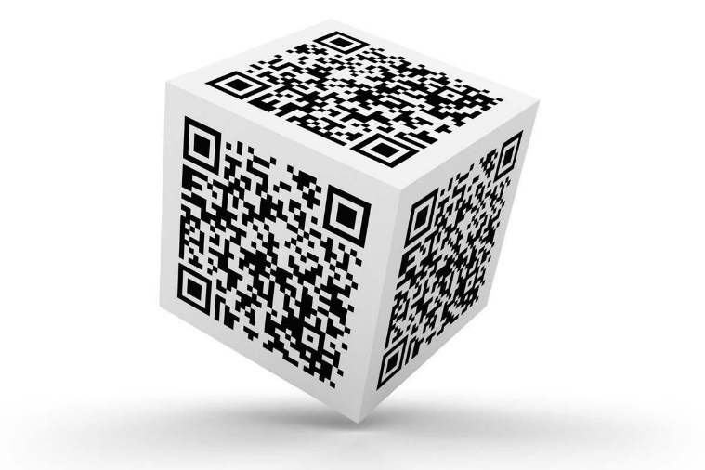
Problem Statement & Requirements
The main intention behind developing this app is to speed up the attendance taking process.
QR Codes can be scanned within fraction of seconds. Why not use this technology to take the attendance for the entire class in just under 1-2 mins.
This system also avoids the use of conventional paper-register method.
Requirements:
QR code scanner / laptop with webcam
Python versions: 2.7.X, 3.6.X
Python modules: MyQR TKinter(tk, tk-tools) pyzbar CV2 (opencv-python)
Pre-generated QR code cards

Slide 3
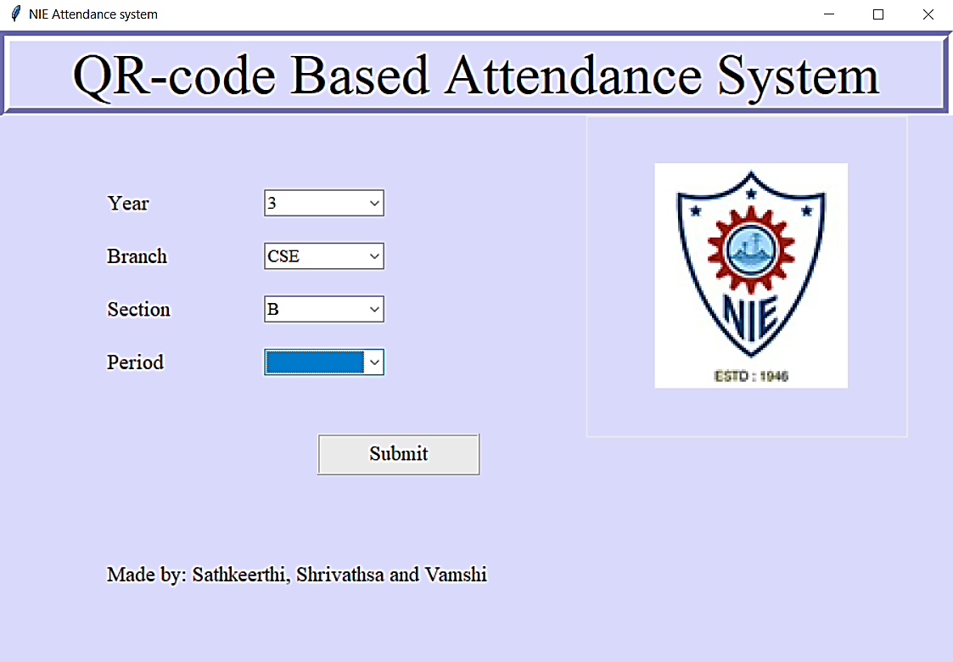
Design
GUI mini-interface is used to set branch, year and other important parameters.
After Submitting, this will open a frame that scans QR codes.
GUI mini-interface before scanning

Slide 4
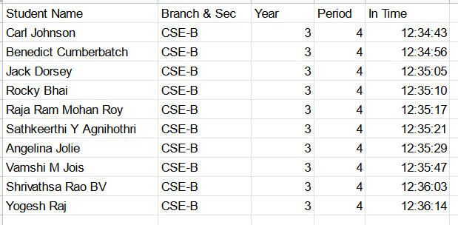
Results & Conclusion
Improvises existing system by a ton
Cost efficient
Accurate time-bound attendance monitoring
Effortlessly convertible Excel format (.xlsx) is highly desirable and easily importable universally
Higher flexibility in modifying attendance report
Unlike papers, this is not subject to corrosion / ink blotting, etc.
Final report prototype

